Slide 1
Terraform plan
OW

Slide 2
Overview
The terraform plan command creates an execution plan, which lets you preview the changes that Terraform plans to make to your infrastructure. By default, when Terraform creates a plan it:
Reads the current state of any already-existing remote objects to make sure that the Terraform state is up-to-date.
Compares the current configuration to the prior state and noting any differences.

Slide 3
How it works
The terraform plan command creates an execution plan, which lets you preview the changes that Terraform plans to make to your infrastructure. By default, when Terraform creates a plan it:
Reads the current state of any already-existing remote objects to make sure that the Terraform state is up-to-date.
Compares the current configuration to the prior state and noting any differences.
Reads the configuration files and the current state of your infrastructure (from the state file).
Analyzes the differences between the current state and the desired state defined in the configuration files.

Slide 4
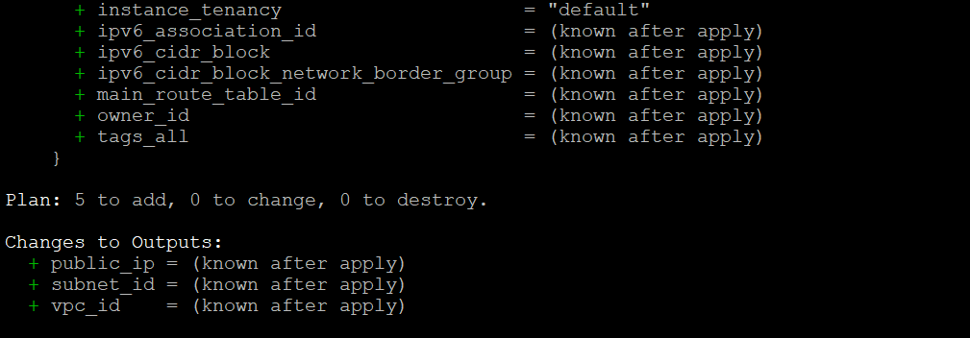
When you execute terraform plan

Slide 5
Can I store this output of terraform plan? Yes
Sharing the Terraform plan output allows team members to review proposed changes before applying them.
The Terraform plan output serves as documentation of the planned changes to your infrastructure.
It provides a snapshot of the proposed modifications to the infrastructure at a specific point in time
Storing Terraform plan outputs can aid in troubleshooting if issues arise during or after applying changes.
It provides a reference point for investigating any discrepancies between the planned and current infrastructure states.

Slide 6
cmds
terraform plan
This command will generate and show an execution plan, but it won't apply the changes.
terraform plan -out=tfplan
terraform plan -parallelism=2
terraform plan –refresh=true

Slide 7
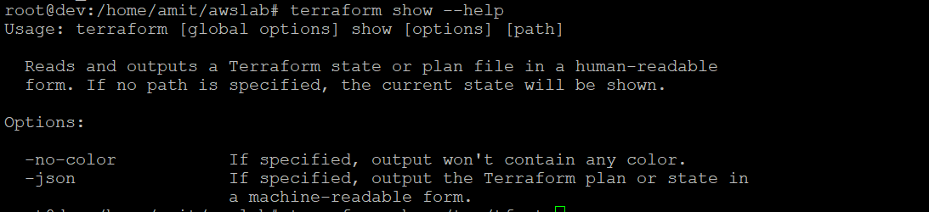
Terraform show
Reads and outputs a Terraform state or plan file in a human-readable
form. If no path is specified, the current state will be shown.

Slide 8
How to review
terraform plan -out /tmp/tflan
terraform show /tmp/tfplan

